Slide 1

EDUCATIONAL PLATFORM FOR LEARNING IoT
Department of INTERNET OF THINGS
(Supervisor: Ms. Neha Katiyar)
Group Members
Name of Member | Roll Number | Role
Ayush Sharma | 2101331550022 | Managing Documentation
Jatin Kumar | 2101331550038 | Managing Styling
Sachin Rawat | 2101331550067 | Managing Structure

Slide 2
Introduction
Internet of thing is an emerging technology and the potential of IOT cannot be measured via some states ,so there are many people who want to know more about IOT .
And as a student who is going to pursue career in IOT we want to contribute in its advancement however we can ,so we are creating a learning platform for Internet of thing .
IoT is a rapidly growing field with significant potential for future job opportunities, and this platform will provide students with valuable skills and knowledge..
Learning platform for Internet of Things

Slide 3


Problem Statement
Identification of the problem or need for the project: Current educational resources on IoT are limited, and there is a need for a comprehensive platform that can teach students about IoT and its applications.
Explanation of why the problem is important and how it affects education and IoT: Lack of educational resources on IoT can lead to a skills gap in the industry and limit the potential for innovation and growth.
Discussion of the challenges and limitations of existing solutions to the problem: Existing educational resources on IoT are often outdated and fail to provide a comprehensive understanding of the subject.

Slide 4
Literature Survey
Researcher | Abstract | Publish year
Andre Hora | Developers often search for software resources on the web. In practice, instead of going directly to websites thus not finding what they really want to know.[1] | 2021
Chengkun | Web search queries reveal extensive sensitive information about users’ interests and preferences to the search engines and eavesdroppers.[2] | 2018

Slide 5
Literature Survey
Researcher | Abstract | Publish year
Aaron Paul M. Dela Rosa | Applications development, e-learning, Mandarin Chinese language, web applications, web development[3] | 2023
João Pedro Cunha | Web development, cybersecurity, vulnerabilities, owasp[4] | 2022

Slide 6
Literature Survey
Researcher | Abstract | Publish year
X. Wang, J. Zhang, and C. Liu | This paper proposes a cloud-based IoT education platform that integrates virtual simulation and physical experimentation to teach students about IoT. The platform allows students to design and test their own IoT systems and applications, providing a comprehensive and hands-on learning experience.[5] | 2018
P. Gope and Y. H. Kim | This study investigates the effectiveness of using virtual reality simulations in teaching IoT to engineering students. The results suggest that virtual simulations can improve student engagement and understanding of IoT concepts.[6] | 2019

Slide 7
M. A. Al-Fuqaha, et al. | This paper provides a comprehensive review of IoT technologies, applications, and challenges. The review covers various aspects of IoT, including architecture, protocols, security, and privacy. The paper also discusses the potential impact of IoT on various industries and society as a whole.[7] | 2015
P. Gope and Y. H. Kim | This study investigates the effectiveness of using virtual reality simulations in teaching IoT to engineering students. The results suggest that virtual simulations can improve student engagement and understanding of IoT concepts.[8] | 2019

Slide 8
M. J. Mukerji and J. R. Iyer. | This paper proposes a project-based approach to teaching IoT, where students work on real-world IoT projects in teams. The approach provides students with practical experience and encourages creativity and innovation. The paper also discusses the challenges and benefits of implementing such an approach in the classroom.[9] | 2018
C. H. Liu, et al | This study investigates the use of gamification in teaching IoT to undergraduate students. The results suggest that gamification can increase student motivation and engagement, leading to better learning outcomes.[10] | 2017

Slide 9
S. Al-Fedaghi and H. A. Alsabah. | This paper proposes a blended learning approach to teaching IoT, where online resources and in-class activities are combined to create a comprehensive and flexible learning experience. The approach is designed to accommodate different learning styles and preferences, while also providing opportunities for collaboration and interaction.[11] | 2020
N. M. Zaini, et al. | This study evaluates the use of online discussion forums in teaching IoT to undergraduate students. The results suggest that online forums can increase student engagement and interaction, leading to better learning outcomes. The study also identifies some challenges and limitations of using online forums in an educational context.[12] | 2020

Slide 10
Proposed Methodology
Website 1
Website 2
Website 3
IOT website
Better and ordered SEQUENCE OF DATA TO USER

Slide 11
IOT Website
HOME
PROJECTS
SIMULATOR
TRY PREMIUM
REGISTER
Search Bar
DEFINITION
IDEAS
TINKERCAD
COMING SOON
EXAMPLES
LINKS
PROTEUS

Slide 12







Hardware /Software Requirements
To use :-
Smart phone/computer with a internet connectivity
To develop:-
html 5 ,CSS 3 , IDE ( vs code version 1.73 ),node.js, node

Slide 13
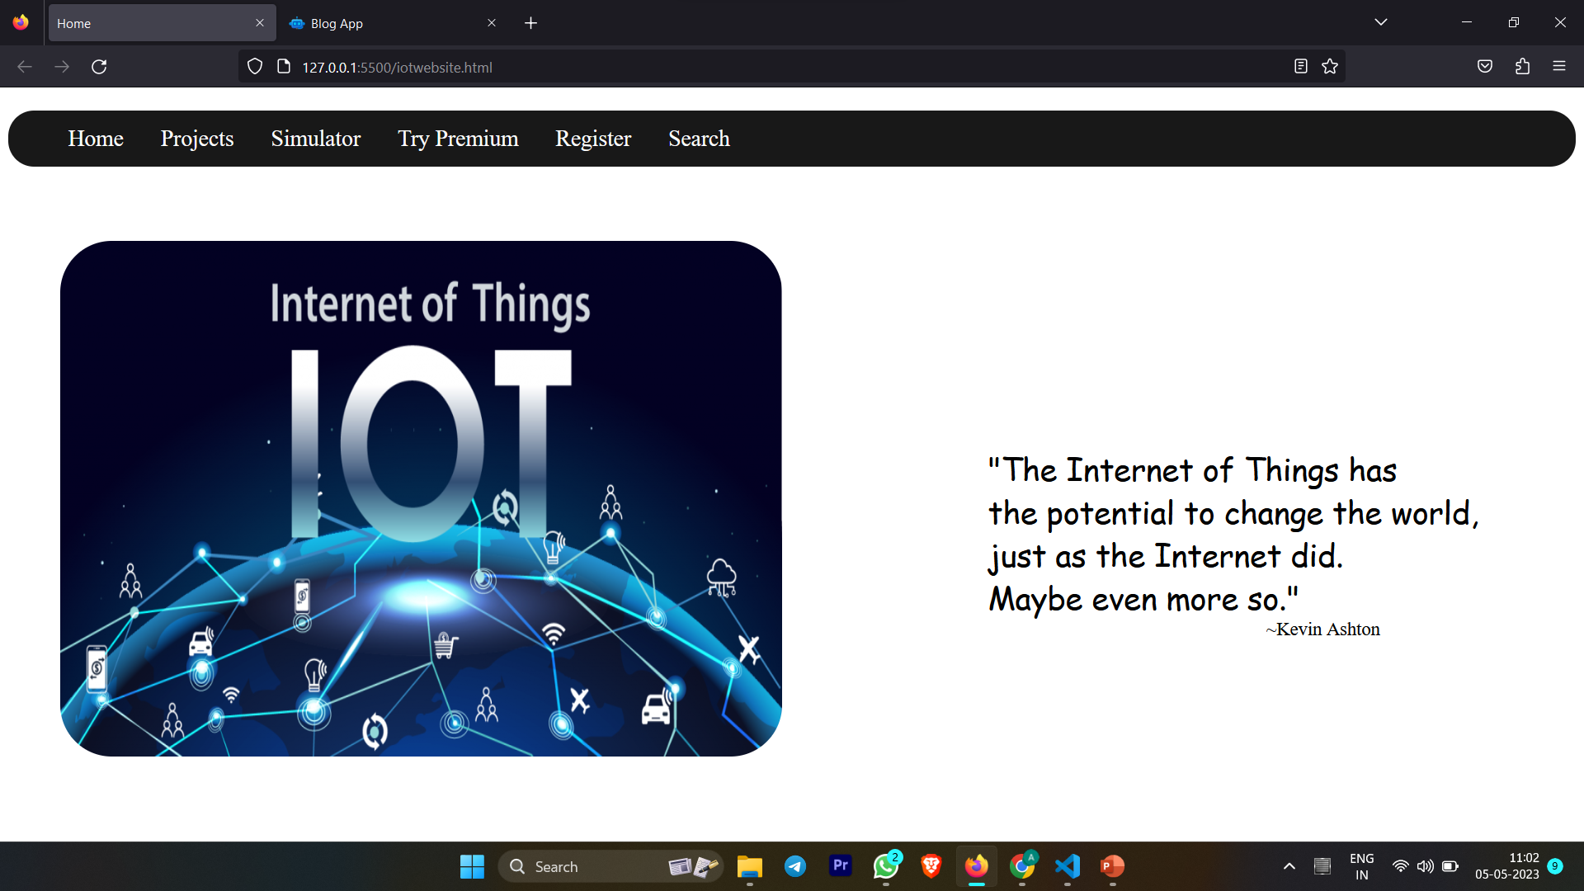
Live Project Progress
Fig no. 1

Slide 14
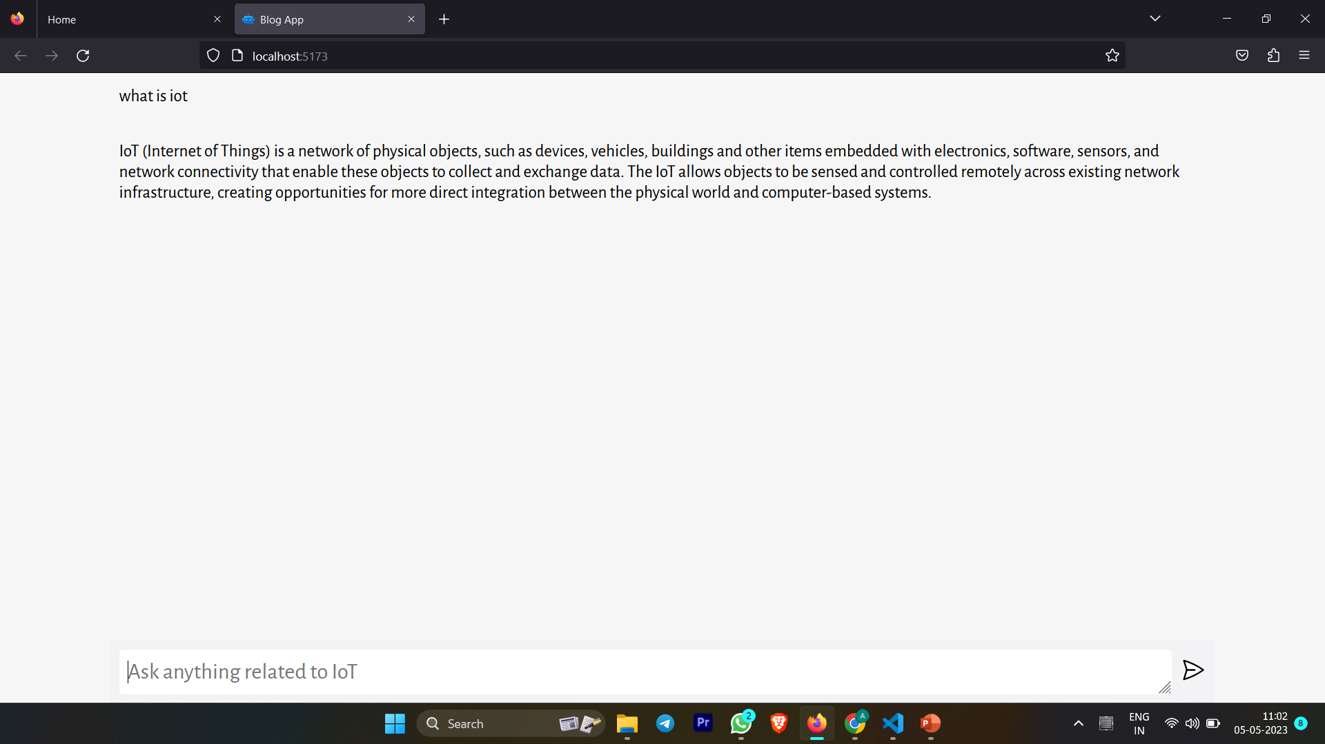
Live Project Progress
Fig no. 2

Slide 15
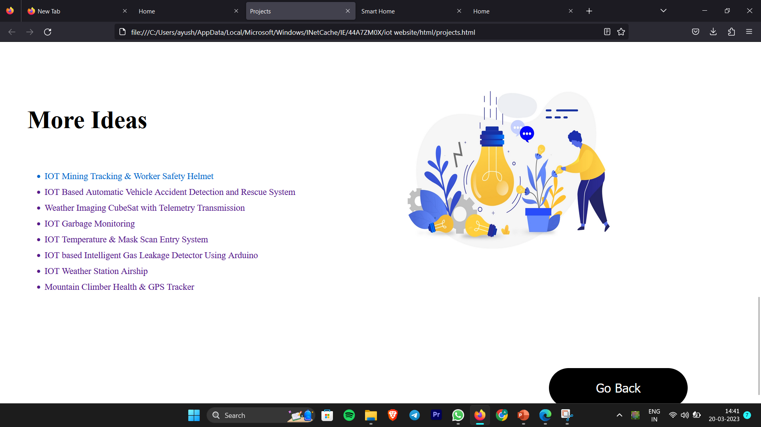
Fig no . 3

Slide 16
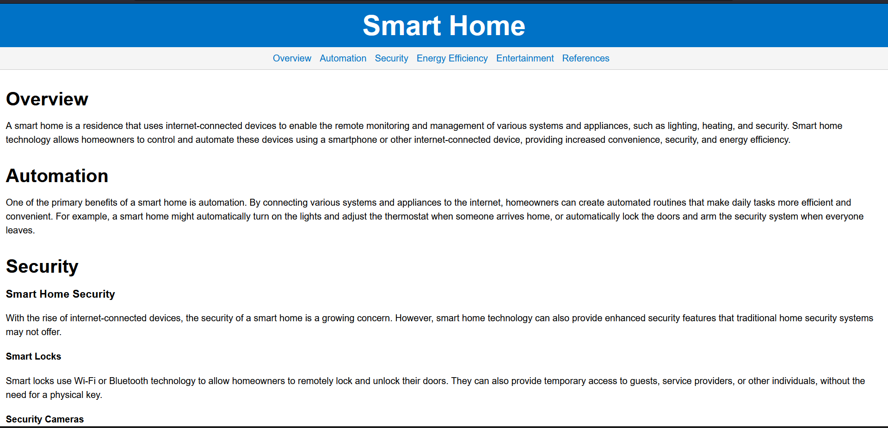
Fig no. 4

Slide 17
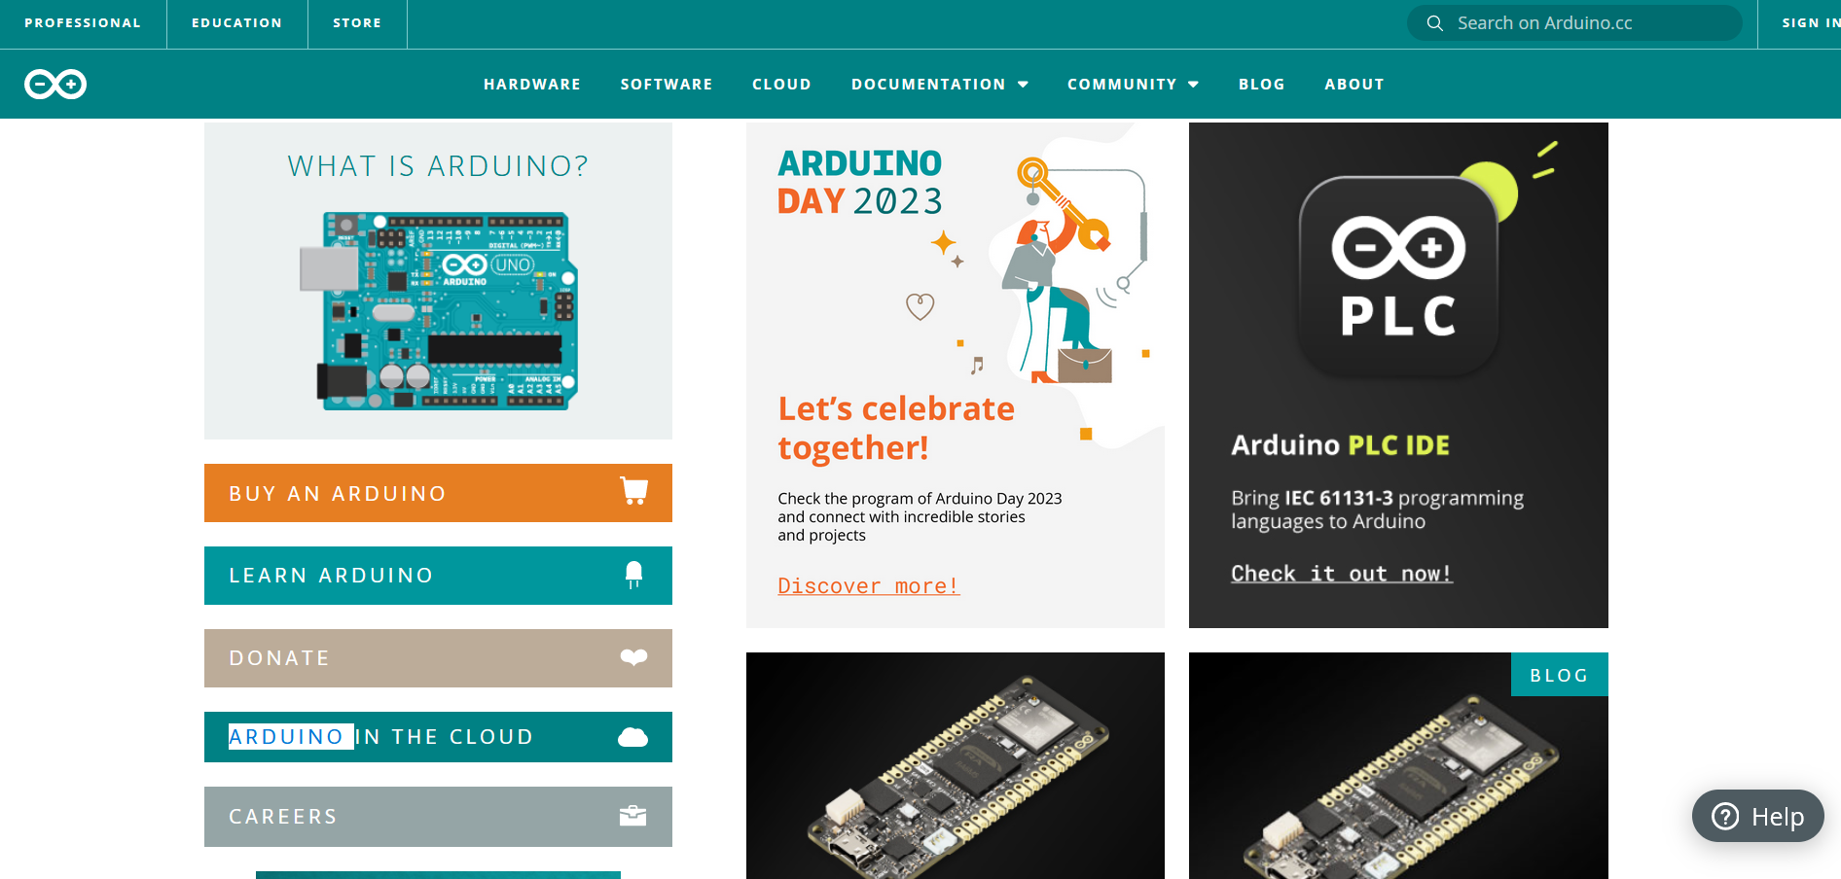
Fig no . 5

Slide 18
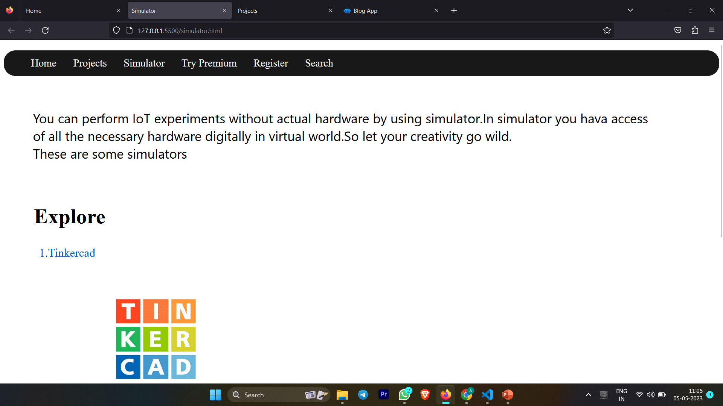
Fig no . 6

Slide 19

Fig no . 7

Slide 20
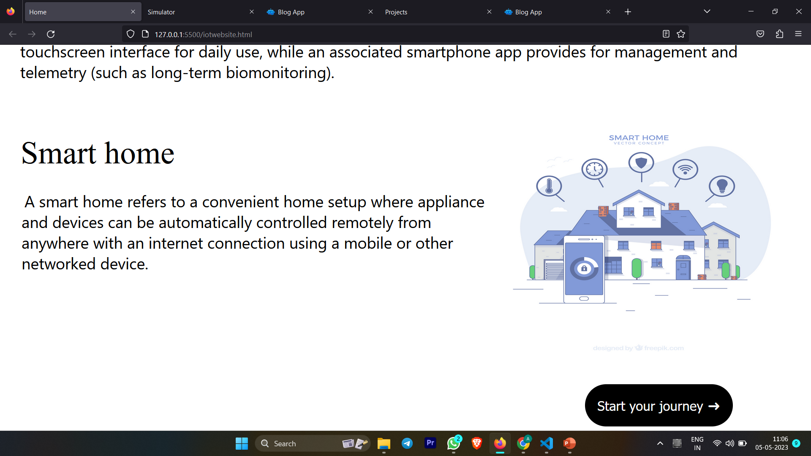
Fig no . 8

Slide 21

Future action plan
Adding more advanced topics
Collaboration with IoT
Incorporation of case studies
Expansion of community forums
Customization of learning paths
Integration with AI and Machine Learning

Slide 22
References
[1] 2021 IEEE/ACM 18th International Conference on Mining Software Repositories (MSR)
[2] DOI 10.1109/TDSC.2019.2962440, IEEE
[3] Internet Of Things: Architecture and Design by MC Graw Hill publication. [4] OWASP "A04:2021 – Insecure Design” [Online]: https://owasp.org/Top10/A04_2021-Insecure_Design/, 2023 [Fev. 15, 2023].
[5]OWASP "A09:2021 – Security Logging and Monitoring Failures [Online]: https://owasp.org/Top10/A09_2021-Security_Logging_and_Monitoring_Failures/, 2023 [Fev. 20, 2023].
[6]X. Wang, J. Zhang, and C. Liu, "A Cloud-Based Internet of Things Education Platform with Virtual Simulation and Physical Experimentation," IEEE Access, vol. 6, pp. 39049-39056, 2018.

Slide 23
REFERENCES
[6]P. Gope and Y. H. Kim, "Teaching Internet of Things (IoT) with Virtual Reality (VR) Simulations," in Proceedings of the IEEE Global Engineering Education Conference (EDUCON), Tenerife, Spain, Apr. 2019, pp. 1003-1007.
[7]M. A. Al-Fuqaha, et al., "Internet of Things: A Survey on Enabling Technologies, Protocols, and Applications," IEEE Communications Surveys & Tutorials, vol. 17, no. 4, pp. 2347-2376, 2015.
[8]M. J. Mukerji and J. R. Iyer, "Project-Based Learning for the Internet of Things," in Proceedings of the IEEE Frontiers in Education Conference (FIE), San Jose, CA, Oct. 2018, pp. 1-5.
[9]C. H. Liu, et al., "Gamification in Teaching the Internet of Things: A Case Study of Undergraduate Courses," IEEE Access, vol. 5, pp. 17239-17246, 2017.
[10]S. Al-Fedaghi and H. A. Alsabah, "Blended Learning Approach for Internet of Things Education," in Proceedings of the IEEE Conference on E-Learning, E-Management and E-Services (IC3e), Kuwait City, Kuwait, Nov. 2020, pp. 90-93.
[11]N. M. Zaini, et al., "The Effect of Online Discussion Forums on Teaching Internet of Things (IoT) to Undergraduate Students," in Proceedings of the IEEE Conference on E-Learni

Slide 24
Thank You

